Slide 1
Machine Learning for IMMOEliza real estate
Hui SHANG
July 23tn, 2024

Slide 2
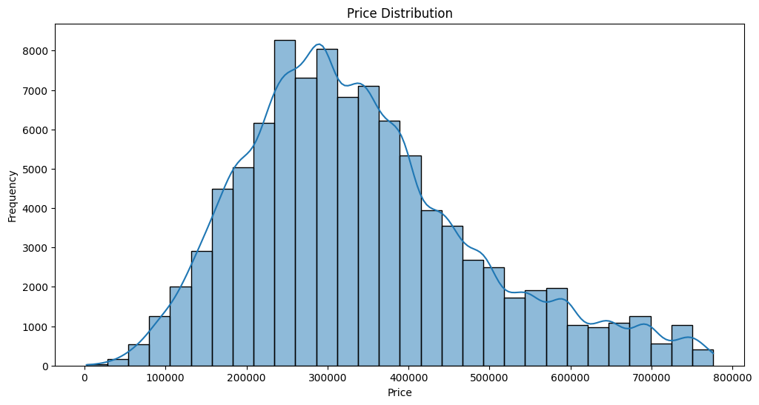
Remove Outliers Using IQR method

Slide 3
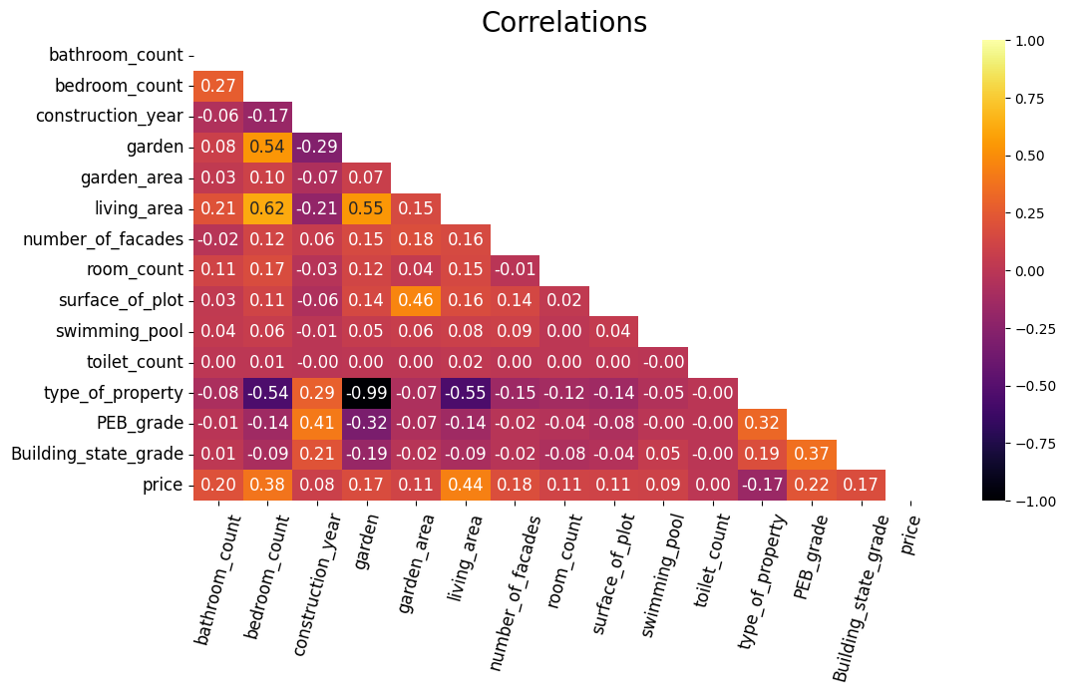

Slide 4
Modeling Results
 | PEB_graded MAE | PEB_non_graded MAE
RandomForest | 68064.41199909725 | 75386.87599207646
GradientBoosting | 70222.05803619919 | 76838.93364809445
XGBoost | 69716.98485641864 | 76378.88588539595

